Slide 1

Synopsis presentation of the proposed thesis Efficient On-Chip Optical Interconnects
Efficient Optical
Interconnects
Eldhose Peter (2013CSZ8108)
Guided by Dr. Smruti Ranjan Sarangi
Dept of CSE, Indian Institute of Technology, New Delhi, India

Slide 2
What will be the future?
Number of cores may reach 1000 in the near future
Both the point to point interconnects and the NOCs will fail to scale
Both in terms of latency and bandwidth

Slide 3
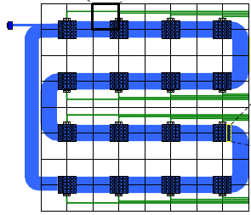
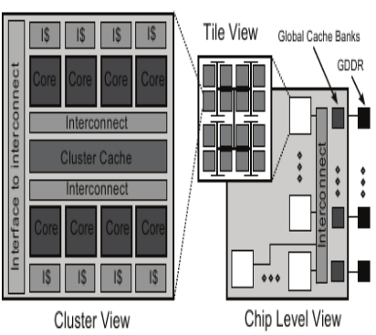
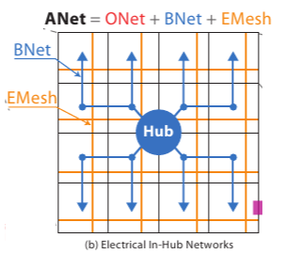
Hold on.. I said 1000 cores!!
Corona, Rigel, ATAC

Slide 4
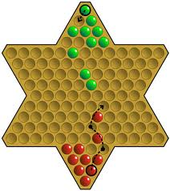
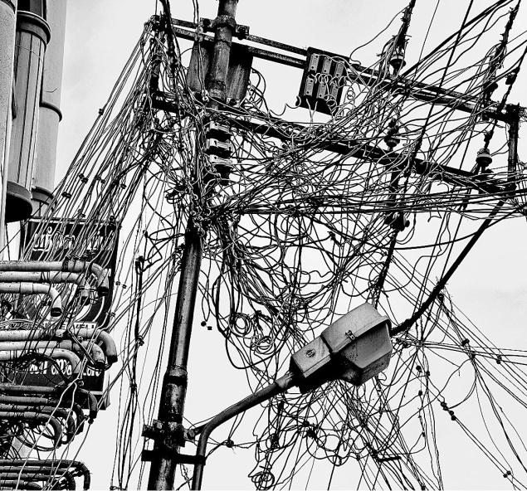
One-to-One or NOC?
One to one interconnection is clumsy(Multiple layers)
NOC
Too many hops

Slide 5
Applications of On-Chip Network
Cache coherence
Invalidation Signals
Barriers
Release signals
Cache bank communication
Communication between processors, memory controller and I/O devices

Slide 6
Do We Need Optical Communication?
Server using On-chip nanophotonics by 2022
Optical
Less Delay
High Bandwidth

Slide 7
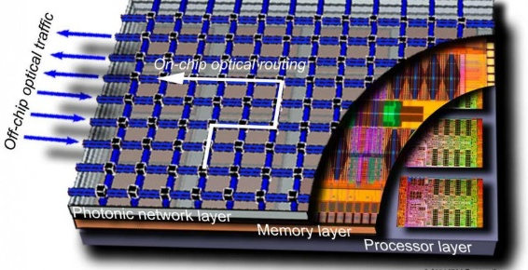
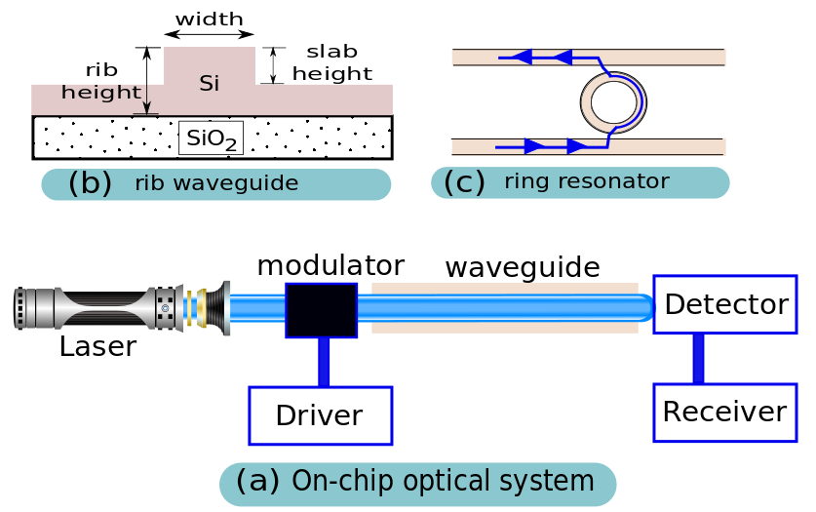
Optical Communication
Fast
High bandwidth
High static power consumption

Slide 8
Prior Works
Important Proposals
Corona
Firefly
ATAC
Probe

Slide 9
Thesis Outline
Part I: Basics of on-chip optical interconnects
Part III: Application of the reconfigurable optical network
Part IV: Advanced network architecture
Chapter 6: Optical Overlay NUCA
Part II : Improvements in design methodology
Chapter 3: Enhancement in simulation infrastructure
Chapter 4: Efficient network synthesis and advanced network reconfiguration methods
Chapter 1: Introduction
Chapter 2: Background and literature survey
Chapter 5: Ultrafast optical components
Chapter 7: Energy efficiency (ColdBus)
Chapter 8: Scalability (BigBus)

Slide 10
Part II : Improvements in design methodology
Chapter 3: Enhancement in simulation infrastructure
Chapter 4: Efficient network synthesis and advanced network reconfiguration methods
Chapter 5: Ultrafast optical components
Part I: Basics of on-chip optical interconnects
Part III: Application of the reconfigurable optical network
Part IV: Advanced network architecture
Chapter 6: Optical Overlay NUCA
Part II : Improvements in design methodology
Chapter 3: Enhancement in simulation infrastructure
Chapter 4: Efficient network synthesis and advanced network reconfiguration methods
Chapter 1: Introduction
Chapter 2: Background and literature survey
Chapter 5: Ultrafast optical components
Chapter 7: Energy efficiency (ColdBus)
Chapter 8: Scalability (BigBus)

Slide 11

Enhancement in simulation infrastructure
To design an optical network, we have to characterize the optical properties of its basic components.
Designed a component library using RSoft CAD tool
Published these components as an open source library named OptiKit[*] (www.cse.iitd.ac.in/~srsarangi/softwares.html)
[*] OptiKit: An Open Source Kit for Simulation of On-Chip Optical Components Eldhose Peter, Smruti R Sarangi 27th International Conference on VLSI Design and 13th International Conference on Embedded Systems 2014, Mumbai

Slide 12
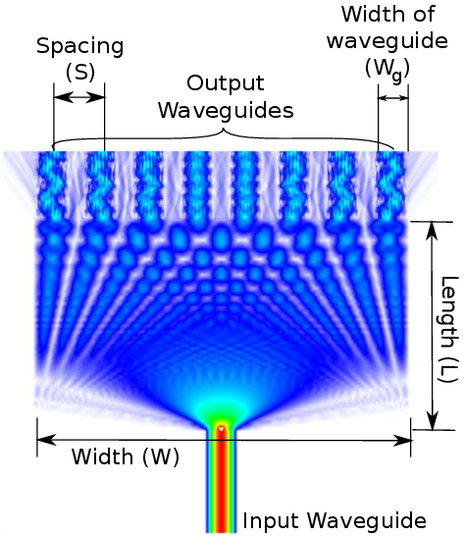
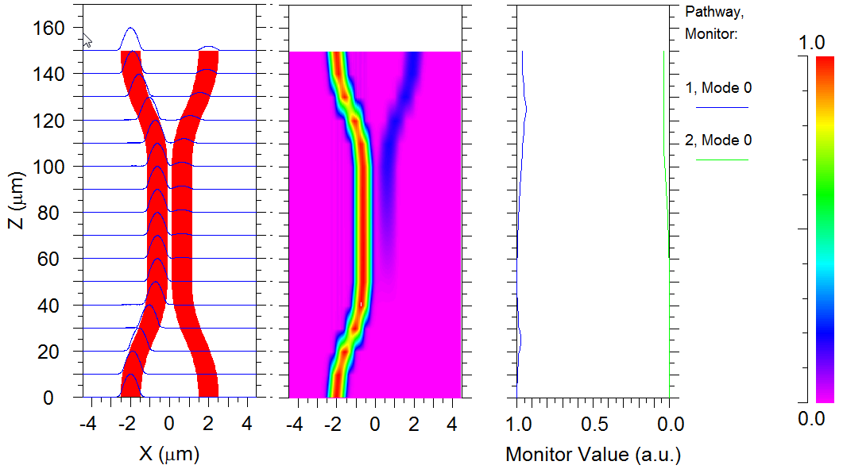
Components I
MMI(Multimode Interference coupler)
Directional Coupler

Slide 13
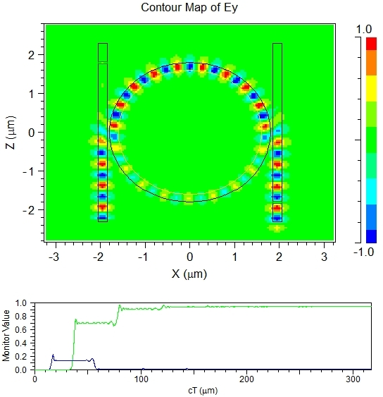
Components II
Microring resonator
Y Junction

Slide 14
Part II : Improvements in design methodology
Chapter 3: Enhancement in simulation infrastructure
Chapter 4: Efficient network synthesis and advanced network reconfiguration methods
Chapter 5: Ultrafast optical components

Slide 15
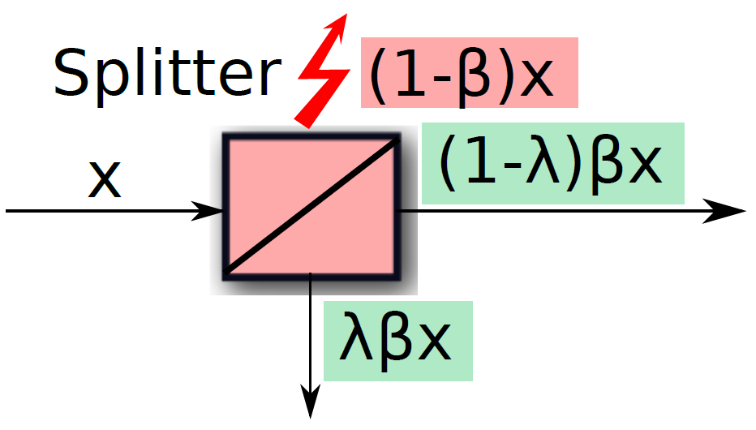
Understand the problem – Single Write Multi Read Bus
Stations
SWMR Bus
λ = split ratio
β = splitter loss
Splitter loss is exponential
Splitter
……….
……….
λβx
(1-λ) λ β²x
(1-λ)^{(i-2)}β^{(i-1)}λx
x
(1-λ)βx
(1-λ) ² β²x
(1-λ)^{(i-1)}β^{(i-1)}x

Slide 16
Where are we now?
Exponential time algorithm
Binzhang et al
Suboptimal algorithm
ATAC, Probe
Tree network
Reduces the variance
Theoretical split ratios (1/n, 1/(n-1)….1/4,1/3,1/2)

Slide 17
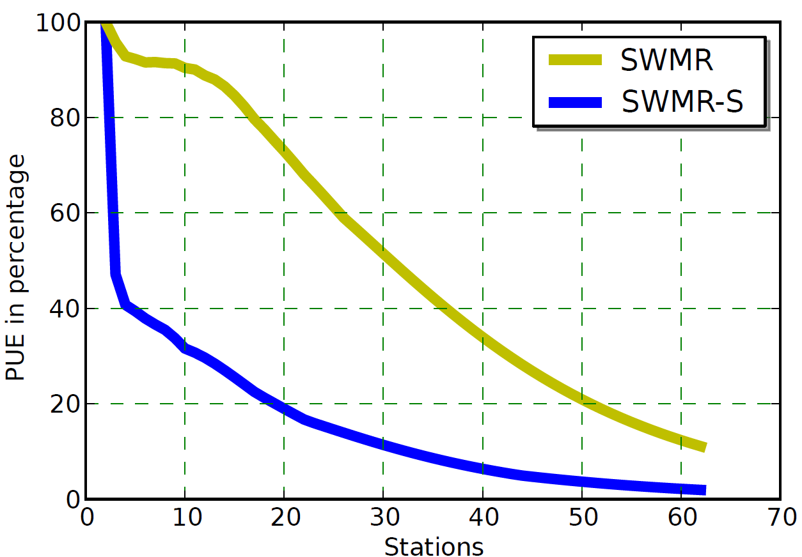
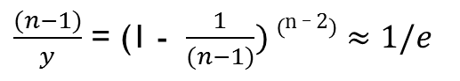
SWMR
When β = 0
…..
1/(n-1)
1/3
1/2
Same split ratio
ATAC and Probe
Different split ratio
β^{(n-1)}(1-λ) ^{(n-2)} λy ≥ 1
Same split ratio
When β = 1, optimal value of λ = 1/(n-1)
Power Utilization Efficiency = $\frac{Ideal Power Transmitted}{Actual Power Transmitted}$
2.718 times
$\frac{(n−1)}{y}$ = (1 - $\frac{1}{(n−1)}) \left(n _ 2\right)≈1/e$

Slide 18
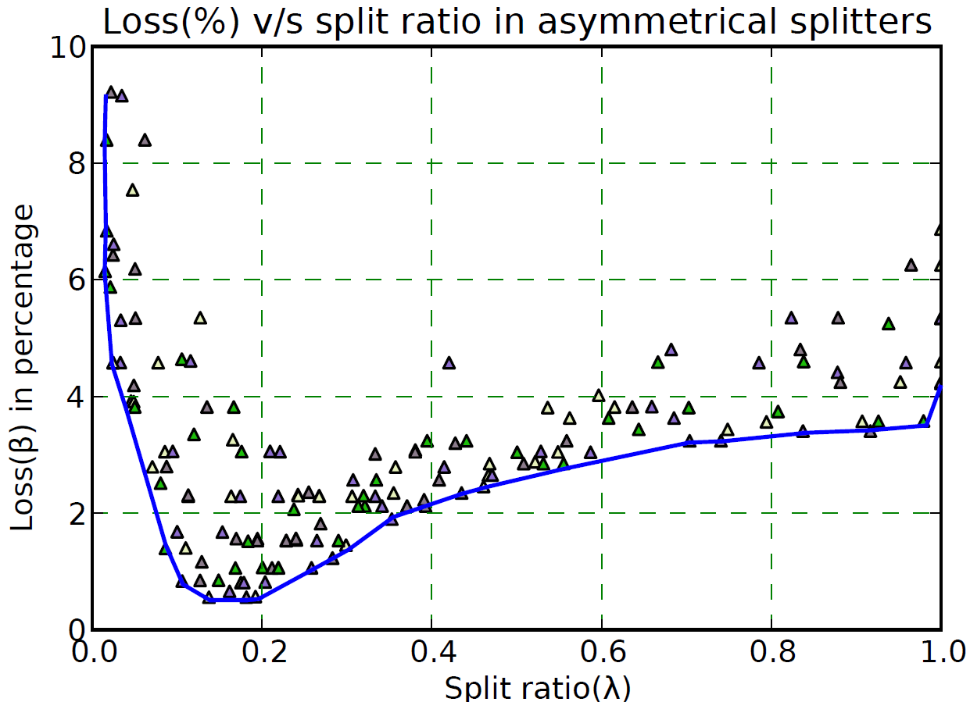
Split Ratio v/s Splitter Loss
200+ candidate designs
Y and DC splitters
β = Ϝ(λ_{i})
Envelope

Slide 19
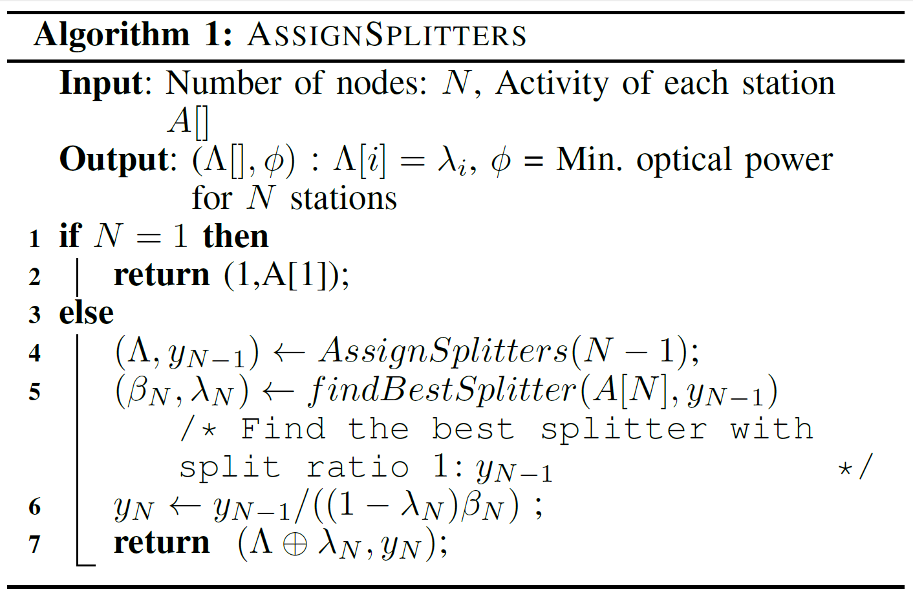
Different Split Ratios –Linear Time Algorithm
Ϝ(λ_{i}) λ_{i}y_{i}≥ A_{i}
Ϝ(λ_{i}) (1-λ_{i} ) y_{i} ≥ y_{i-1}
i^{th} station
Ϝ(λ_{i}) λ_{i}y_{i}
i-1 stations
Ϝ(λ_{i}) (1-λ_{i} ) y_{i}

Slide 20
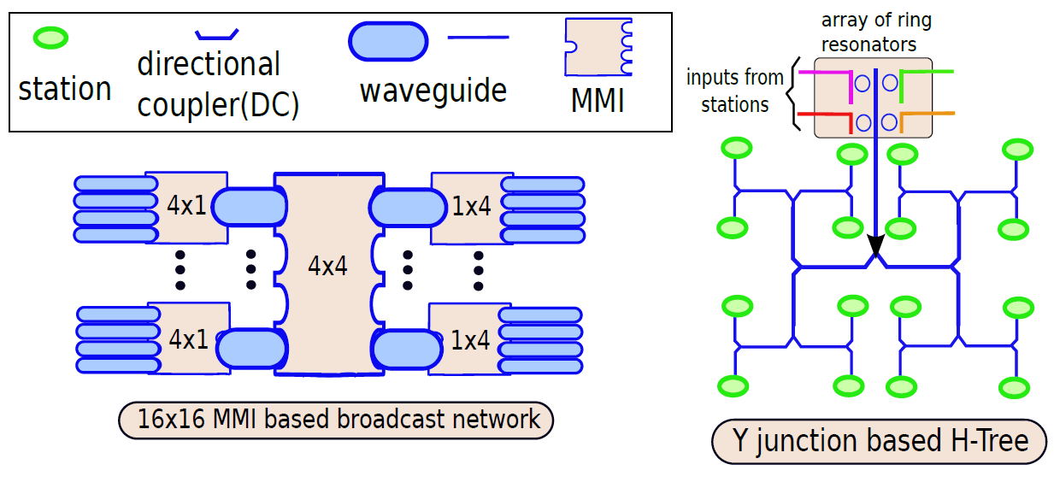
SWMR- Tree

Slide 21
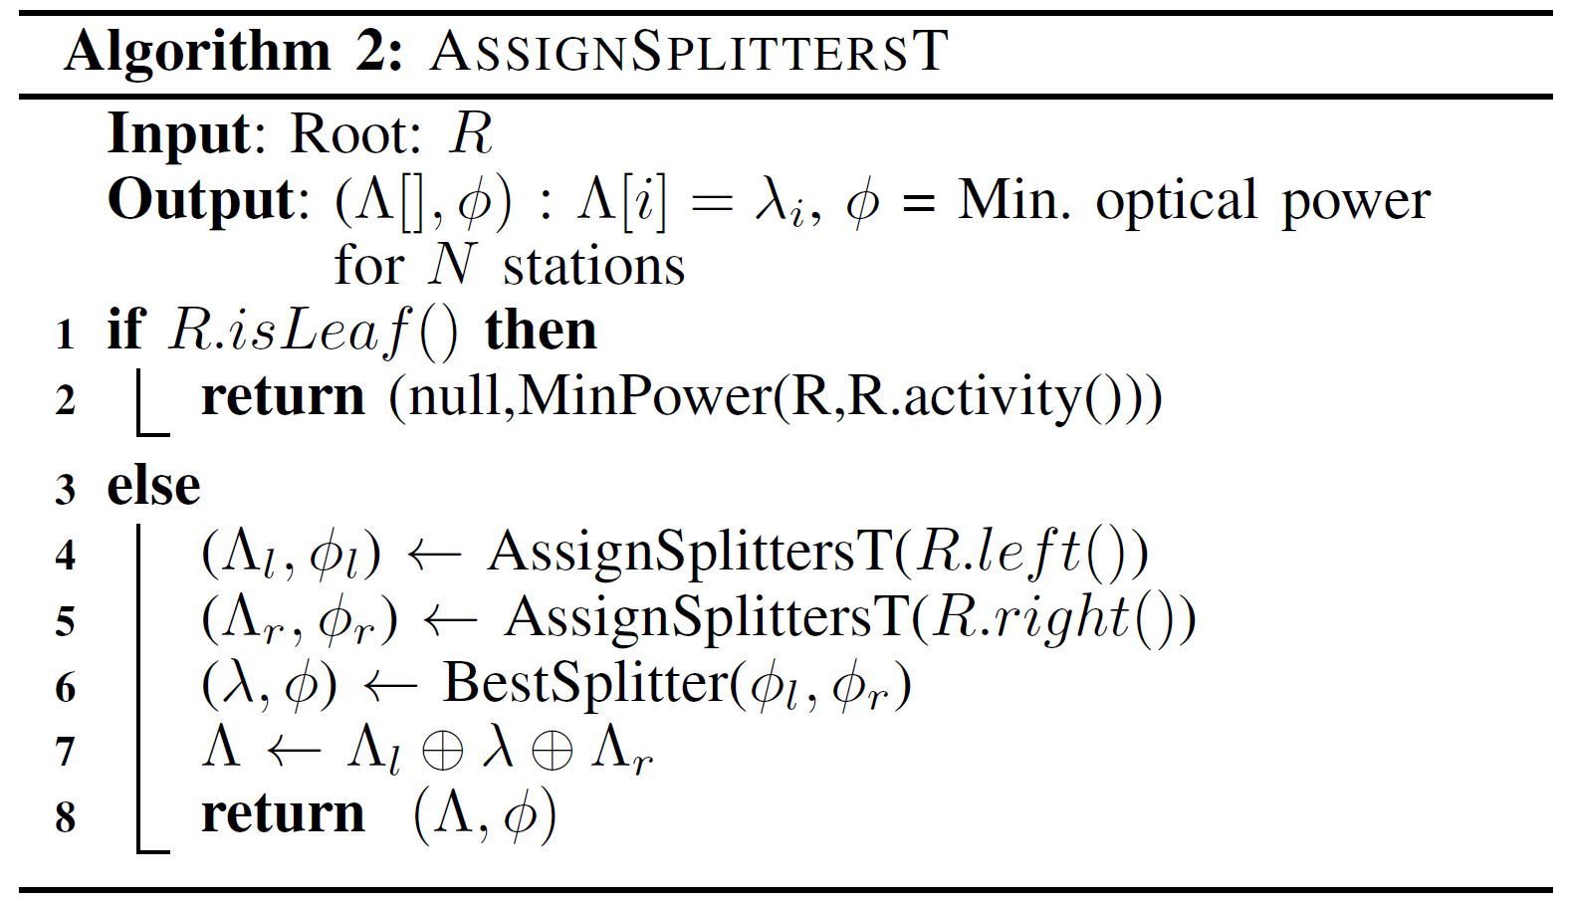
Tree Algorithm
1 → M Splitters
Heterogeneous Splitters
Left sub-tree
Right sub-tree
Combine the results

Slide 22
Tunable Splitters
Hardware Implementation
Ring
Tree
Inactive
…..
18 nm technology
Frequency divider(clock)
Cacti 5.3 simulations
MMI and Microring resonator based tunable splitters

Slide 23
Ring
=> 16 stations in 1 cycle
=> 64 stations in 4 cycles
Tree
Phase 1
Leaf level
4 cycle
Phase 2
Non leaf level
28 cycles

Slide 24
How our work differs?[*]
Linear time optimal dynamic algorithm
Solution is extended for trees and multilevel networks
Considers the relationship between splitter loss and split ratio
Provides solution in hardware for tunable splitters
Scalable for large number of nodes
Energy consumption of ring reduces by 87% and of tree by 90%
[*] Optimal Power Efficient Photonic SWMR Buses Eldhose Peter, Smruti R Sarangi SiPhotonics Workshop in High Performance and Embedded Architecture and Compilation (HiPEAC) 2015, Amsterdam, NETHERLANDS

Slide 25
Part II : Improvements in design methodology
Chapter 3: Enhancement in simulation infrastructure
Chapter 4: Efficient network synthesis and advanced network reconfiguration methods
Chapter 5: Ultrafast optical components

Slide 26
Microring Based Splitter[*]
In
Through
In resonance
Out of resonance
Partial resonance
Drop
[*] Active Microring Based Tunable Optical Power Splitters Eldhose Peter, Arun Thomas, Anuj Dhawan, Smruti R Sarangi Elsevier transactions on optics communication

Slide 27
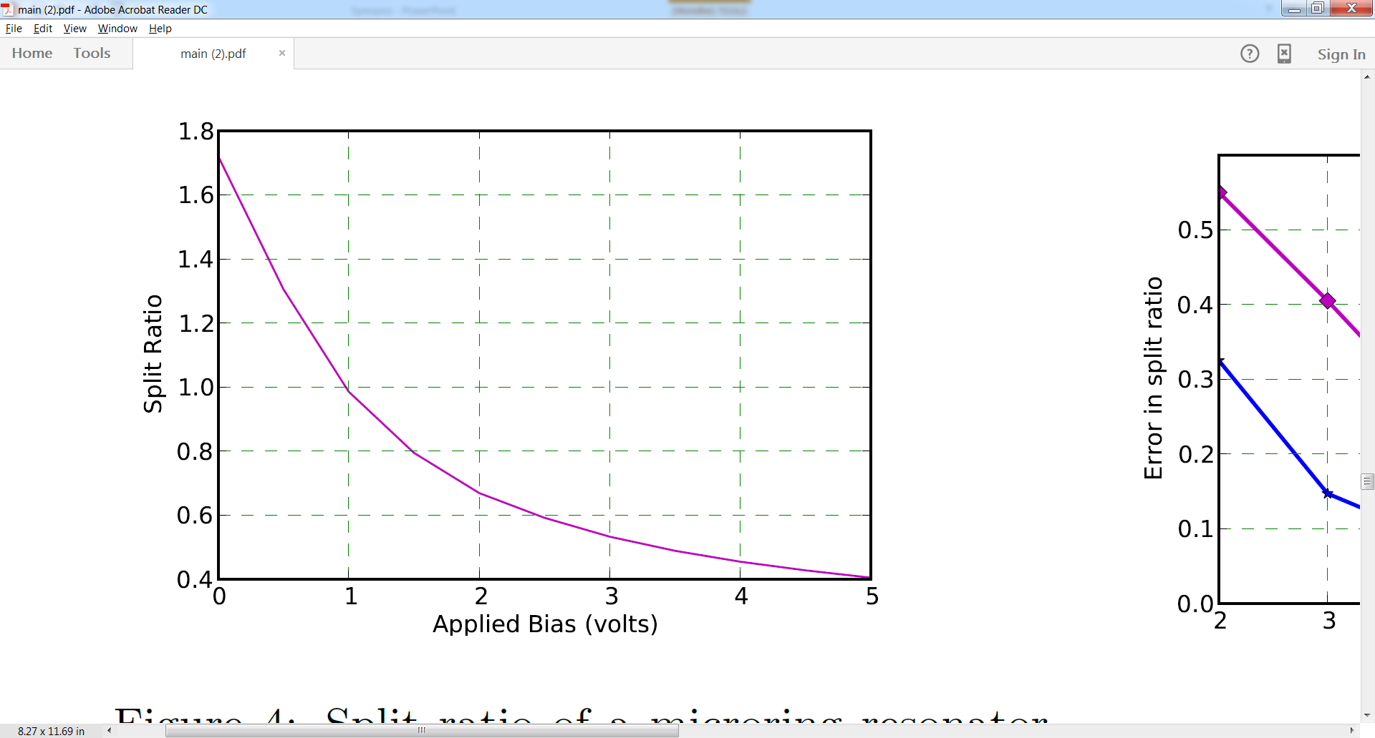
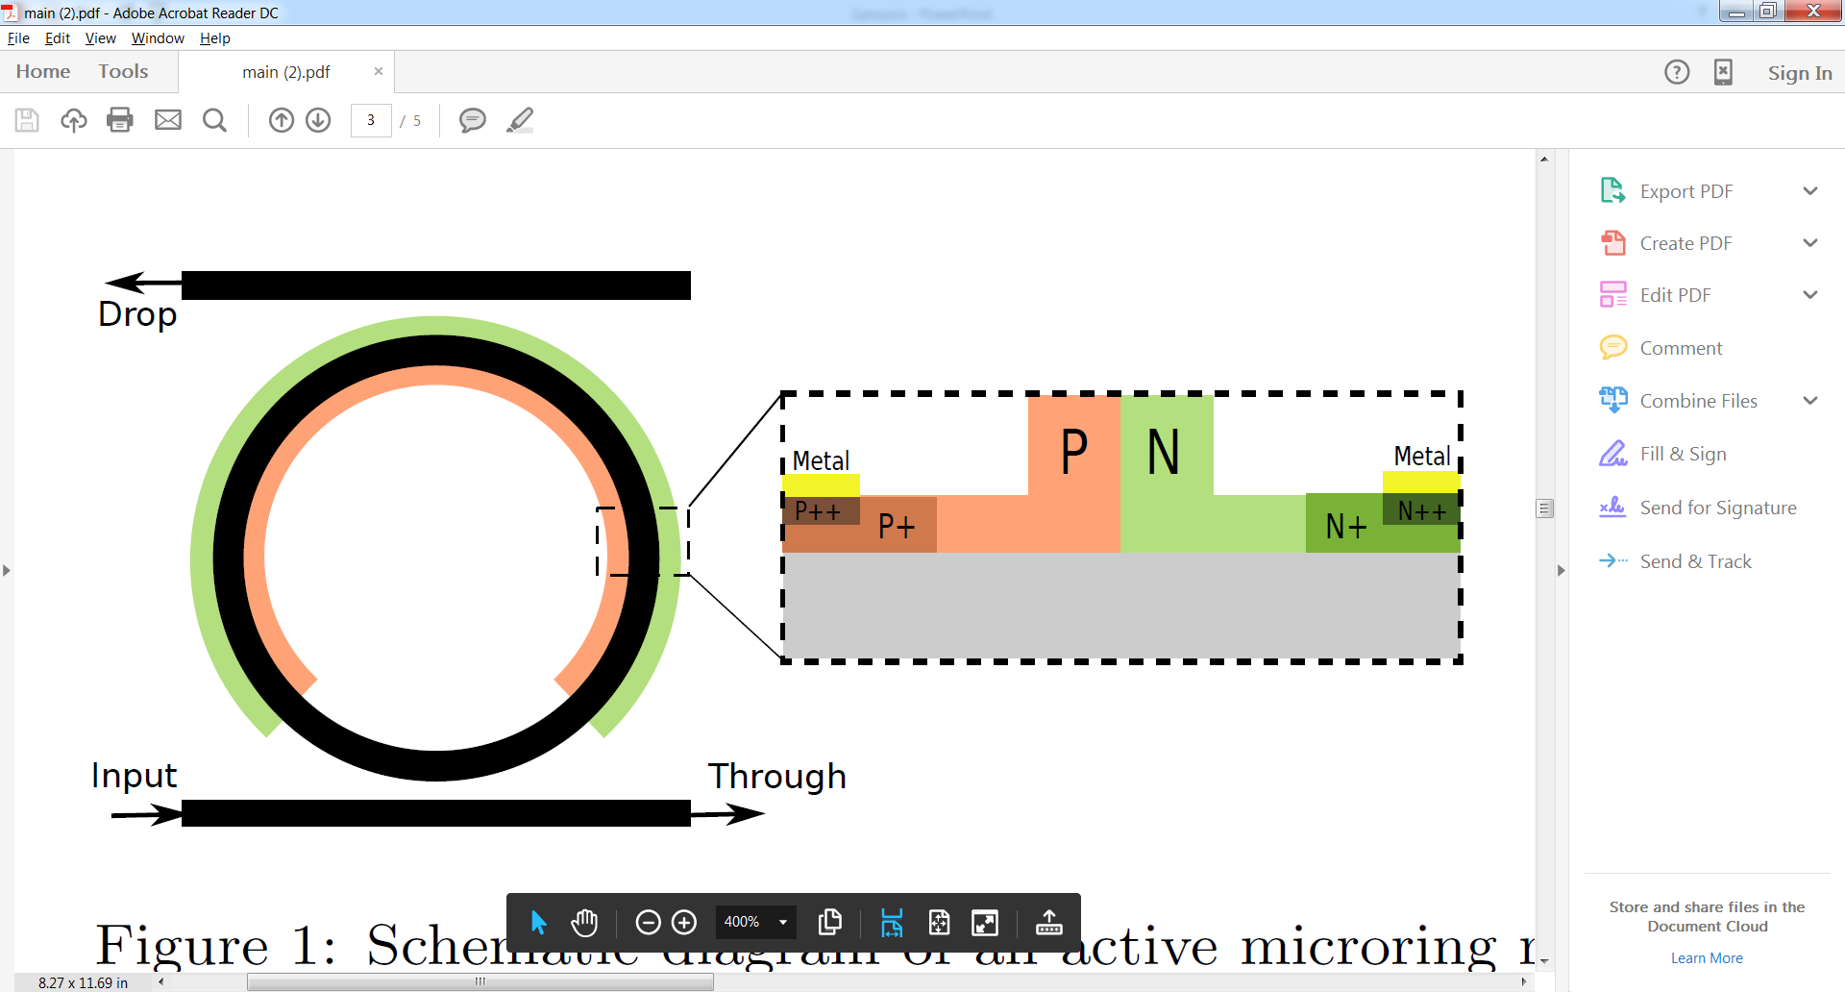
Active Microring Resonator
Changes refractive index => resonant wavelength

Slide 28
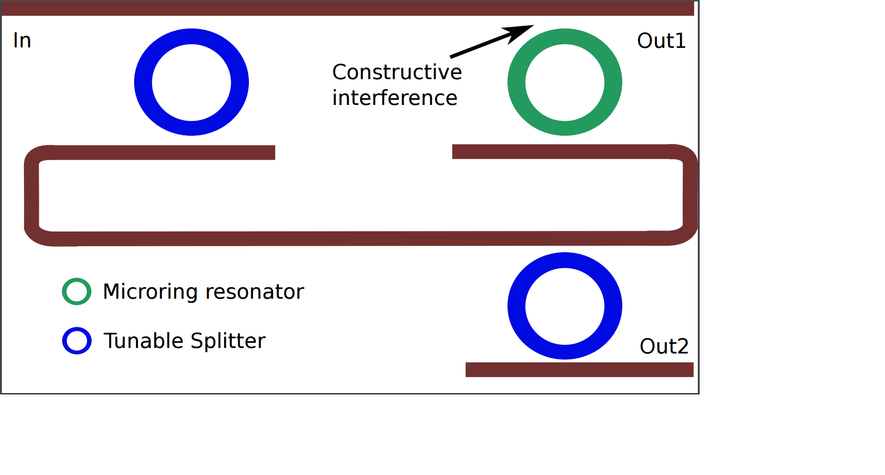
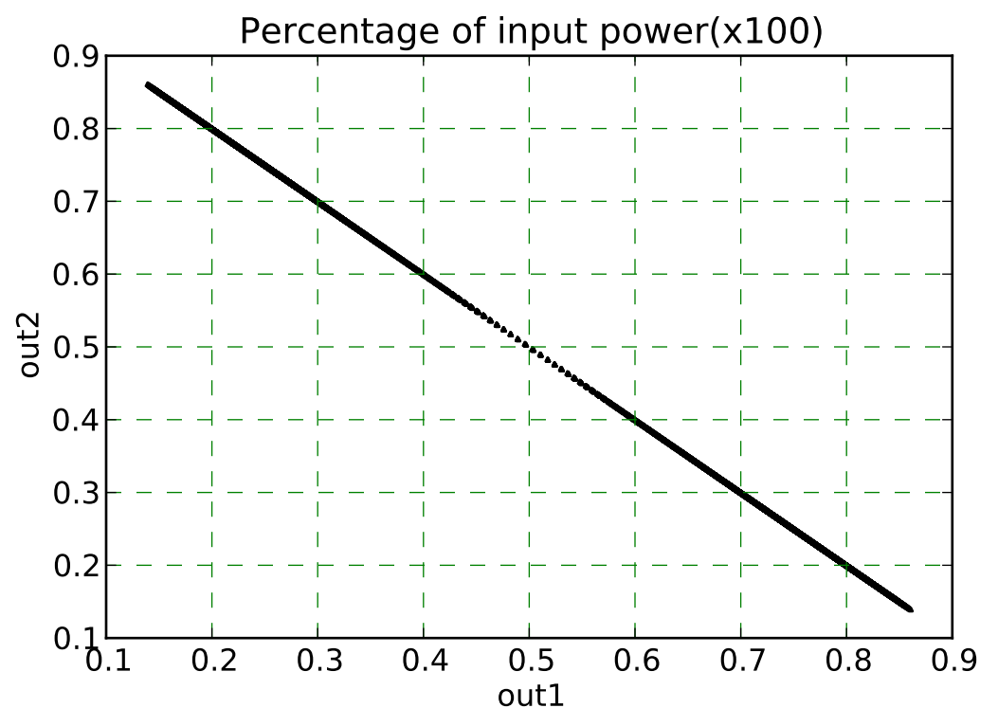
High Split Ratio
15% - 85%

Slide 29
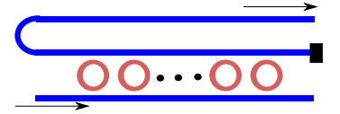
Alternate designs
Array of resonators with different temperatures
Array of resonators with different sizes
Rings with different split ratios
Activate one at a time

Slide 30
Part I: Basics of on-chip optical interconnects
Part III: Application of the reconfigurable optical network
Part IV: Advanced network architecture
Chapter 6: Optical Overlay NUCA
Part II : Improvements in design methodology
Chapter 3: Enhancement in simulation infrastructure
Chapter 4: Efficient network synthesis and advanced network reconfiguration methods
Chapter 1: Introduction
Chapter 2: Background and literature survey
Chapter 5: Ultrafast optical components
Chapter 7: Energy efficiency (ColdBus)
Chapter 8: Scalability (BigBus)
Part III: Application of the reconfigurable optical network
Chapter 6: Optical Overlay NUCA
[*] Optical Overlay NUCA: A High Speed Substrate for Shared L2 Caches Eldhose Peter, Anuj Arora, Akriti Bagaria, Smruti R Sarangi,
21st annual IEEE International Conference on High Performance Computing (HiPC) 2014, Goa
&
Transactions on Parallel and Distributed Systems – TPDS (Submitted)

Slide 31

Understand the problem - Cache
Cache performance α 1/(hit latency)
Cache performance α hit rate
L1
UCA
Sets
Static => Not adaptable based on access pattern
L2
L2
L2
L2
L2
L2
L2
L2
L2
Improved cache utilization
NUCA
Lower Level Memory

Slide 32
Understand the problem – Optical Communication
L2
L2
L2
L2
L2
L2
L2
L2
L2
L2
L2
L2
L2
L2
L2
L2
L2
L2
L2
L2
L2
L2
L2
L2
L2
L2
L2
L2
L2
L2
L2
L2
Electrical
Optical
50-60 cycles
1-2 cycles

Slide 33
Prior Approaches
No prior work in cache using optical NOC
Electrical NOC
SNUCA
DNUCA
RNUCA
L1
Migration near to the core
L2
L2
L2
L2
Search
L2
L2
L2
L2
Lower Level Memory
Tag
Set Index
Block Size
111010101110001
1000
1000
10100
100011
HomeBank

Slide 34

Equidistant nodes
Banks are equidistant in terms of delay(approx)
Dynamic creation of sets
Improves the utilization of banks
Improves hit rate
I am near to S
X cycles
S
I am also near to S
X cycles

Slide 35
Phases of operation
Phase 1: SNUCA + Profiling
Phase 2 : Reconfiguration
Phase 3 : OONUCA
Then Phase 2, Phase 3, Phase 2, Phase 3 and so on

Slide 36
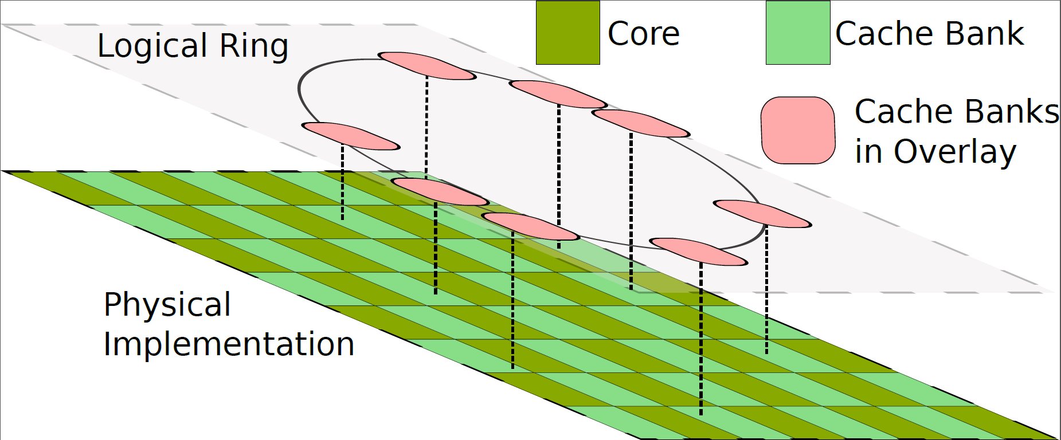
Optical Overlay
Profiling information – Cache bank accesses, bank contention, cache lines used

Slide 37
Creation of overlay
High
Low
1
20
4
5
13
6
7
8
30
2
3
Hybrid
17
19
8
3
9
10
14
12
13
14
15
16
6
11
Infreq
31
20
21
22
4
24
17
18
19
23
26
25
7
12
25
26
27
28
29
30
31
32
15
5
29
32
11
16
23
28
10

Slide 38
TSI, BCAST and OP_BCAST
Home Bank
Base Bank set
Home Bank
2
23
15
27
23
20
5
27
20
2
15
18
31
18
31
Overflow Bank set
OP_BCAST
5
Two-Side Incremental (TSI)
Broadcast

Slide 39
Home Bank Controller
Main memory Read
Response Collection Buffer
Main memory Write
Main Memory
Message ID | Block Addr | MRBV
Response to the sender
Miss
Eviction Logic
Hit
Victim Buffer
Migrate block
Miss
Overlay Info store
Evicted block
Cache Bank
NACK Message
NACK controller
Fill Bank
Read/Write
Response
Forward request to other banks
Search Logic
Notify
Full
Message Queue
Hit
To core
Read/Write
Search Bank
Kill controller
Kill

Slide 40
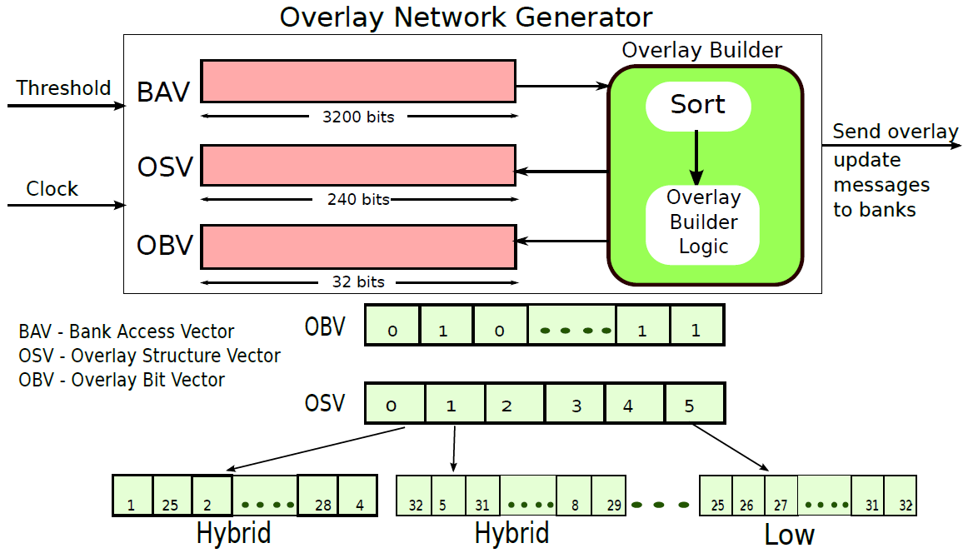
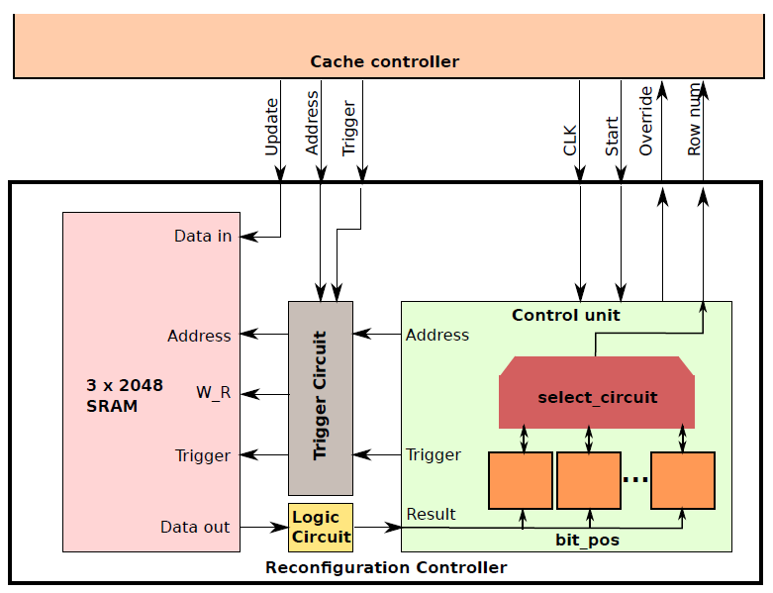
Reconfiguration
Cadence tool
2048 cache lines => 128 cycles
1033 µm²

Slide 41
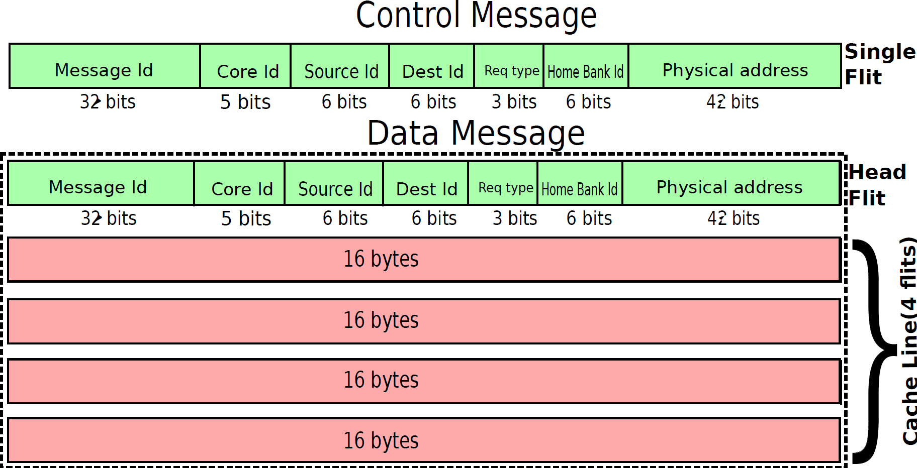
Message Structure
Control Message
1 Flit – 3 cycles
Data Message
5 Flits – 7 cycles
NACK, Kill, Notify
Request, Response

Slide 42
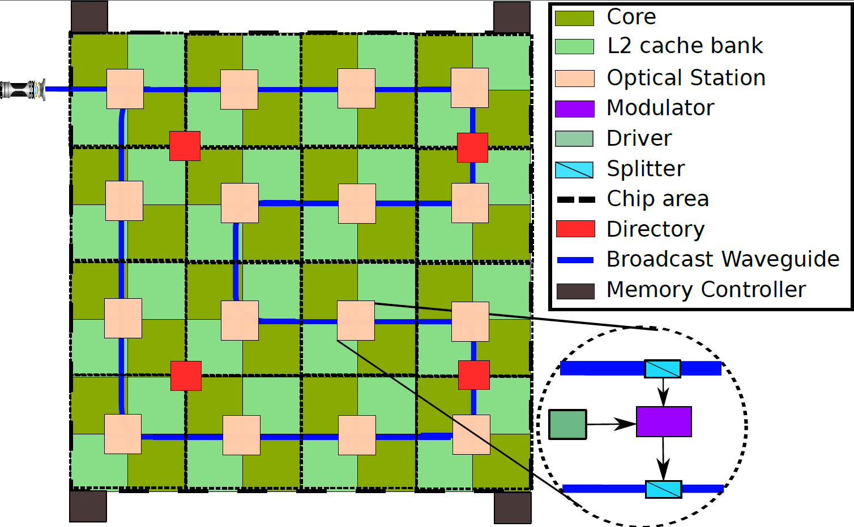
Architecture
32 cores and 32 cache banks
Clustered architecture – 16 stations
Distribute directory
Off chip laser

Slide 43
What we achieved
Flexible and efficient access mechanism for large shared L2 caches
Mean speedup of 34% over SNUCA and 7% over TSI
Periodic network reconfiguration mechanism based on program characteristics
Number of bank accesses in OP_BCAST is reduced by 33% compared to broadcast
Proposal is agnostic to the network topology

Slide 44
Part I: Basics of on-chip optical interconnects
Part III: Application of the reconfigurable optical network
Part IV: Advanced network architecture
Chapter 6: Optical Overlay NUCA
Part II : Improvements in design methodology
Chapter 3: Enhancement in simulation infrastructure
Chapter 4: Efficient network synthesis and advanced network reconfiguration methods
Chapter 1: Introduction
Chapter 2: Background and literature survey
Chapter 5: Ultrafast optical components
Chapter 7: Energy efficiency (ColdBus)
Chapter 8: Scalability (BigBus)
Part IV: Advanced network architecture
Chapter 7: Energy efficiency (ColdBus)
Chapter 8: Scalability (BigBus)

Slide 45
Optical Communication - Detailed
The Laser is kept ON all the time
Splitter
Modulated signal
Draws
power
Data Waveguide
Nodes
Power Waveguide

Slide 46
How to save static power consumption?
Laser modulation
Change laser output
Inactive Stations
Bandwidth sharing
Multiple stations share the input laser power

Slide 47
Laser Modulation
0:1
1:1
1:3
1:2
4
2
3
2
1
1
2
1
1
1
1
1
1:0
0:1
1:0
1:1

Slide 48
Bandwidth Sharing
Power Waveguide
Arbitration Waveguide

Slide 49
Where are we now?
Modulate Laser Power based on traffic
Reservation assisted SWMR
Share Bandwidth
Flexishare – stations are not active at a time
Ecolaser – turn laser on/off(without prediction)
Probe – link and buffer utilization based prediction
Pulse – predicts sharers of cache line
Wavelength stealing
Pairing of nodes
Backbone WG
ColdBus
Extra WG

Slide 50
How our work differs?
A novel predictor for network activity
A mechanism to handle misprediction – Extra WG
A new laser modulation scheme with multiple DML lasers
Detailed bus design and reconfiguration
A technique to leverage both the laser modulation and bandwidth sharing
[*] ColdBus: A Near-Optimal Power Efficient Optical Bus Eldhose Peter, Arun Thomas, Anuj Dhawan, Smruti R Sarangi 22nd annual IEEE International Conference on High Performance Computing (HiPC) 2015

Slide 51
Layout
Private L1
Shared L2
Coherence messages
Array of 32 DML lasers
Fast Turn ON
Multiple output levels
Intracluster - Electrical
Intercluster - Optical

Slide 52

Operation
Reconfigu-
ration
Split ratio
Power
Normal
Phase
Draw power
Send message
Prediction
Backbone
Extra WG
An Epoch Duration

Slide 53
Prediction & Reconfiguration
Address Based Prediction
Predict L1 miss in fetch stage
Extra Predictor
Based on the average wait time
Reconfiguration
Split ratio
If miss then Miss time predictor(out of order pipeline)
Laser power for the next epoch
To predict the epoch in which miss is going to happen
Mis-prediction by address based predictor
For the extra waveguide
For the backbone waveguide

Slide 54
Working of ColdBus
Backbone
WG
Data Transfer
Misprediction?
Couples light to another WG
Resonator
Station Controller
SWMR WG
Reservation
Channel
Extra WG
Message Queue
Predictor WG
ERP WG
Input Power
Prediction

Slide 55
Performance
Compared to the state of the art systems, ColdBus is
4.1X better in terms of power
3.1% faster
Shows 18% improvement in ED²

Slide 56
Part IV: Advanced network architecture
Chapter 7: Energy efficiency (ColdBus)
Chapter 8: Scalability (BigBus)

Slide 57
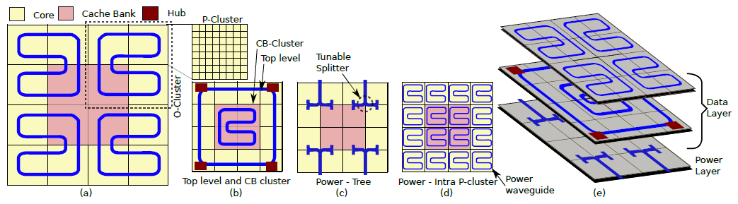
BigBus Architecture[*]
Partially shared data waveguide(O-Link)
Power sharing-
Reduces power consumption
Division reduces
the number of
cascading nodes
Multiple lasers
1 laser=> 4 P-Cluster
Multiple levels reduces
the number of crossings
CB Link
[*] OptiShare: A dynamic channel sharing scheme for power efficient on-chip optical interconnects Eldhose Peter, Smruti R Sarangi, Optics workshop in DATE 2016
[*] BigBus: A scalable optical interconnect Eldhose Peter, Smruti R Sarangi, HPCA (Submitted)
Prediction per P-Cluster
The intelligent placement of cores and cache banks reduces the number of hops (O-Link and CB-Link)

Slide 58
Partially Shared O-Link
O-Cluster
P-Cluster1
P-Cluster2
1/4th of the bandwidth is assigned to each P-Cluster
P-Cluster 1
P-Cluster 2
P-Cluster 3
P-Cluster 4
Power
waveguide
P-Cluster3
P-Cluster4
Source: Anyone in P-Cluster 4
Destination: Anyone in the O-Cluster
Data waveguide

Slide 59
Cache Bank Access
O-Cluster1
O-Cluster2
Dynamic Set Creation
Set =>1 Bank in every O-Cluster
No hub b/w O-Link & CB-Link
O-Cluster3
O-Cluster4

Slide 60
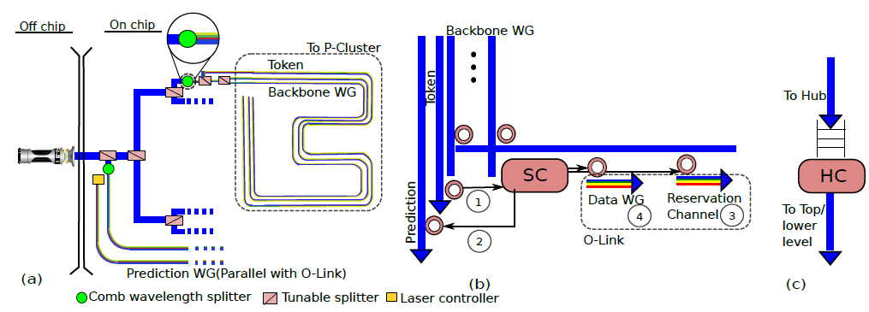
Operation

Slide 61
Message transfer
Any station can dynamically access a power waveguide
Power waveguides
in a p-cluster
i^{th} & j^{th}
waveguide
i^{th} waveguide
j^{th} waveguide
Token i & j
Token
waveguide
Station m
Station n
Token i
Token j
Modulate and
send on WG i & j
Modulate and
send on WG m
Modulate and
send on WG n
Data
Waveguides
Separate arbitration is not needed for the data waveguide

Slide 62
What we achieved
A scalable optical interconnect
Prediction considers the number of pending events and average waiting time
Supports NUCA
Speedup of 14-55% and 9-56% reduction in ED² compared to state of the art schemes
Intelligent placements of network element reduced number of hops for communication

Slide 63

Conclusion
Created an optical network ab initio
Proposed optimal SWMR networks for all the commonly used topologies
Designed energy efficient and scalable on-chip optical interconnects
Used the efficient interconnect to implement a novel optical NUCA

Slide 64

Let others do something!
Tunable splitters with a high range of split ratio
Power consumption can be reduced by improving prediction mechanism
Fairer arbitration schemes for BigBus
Mechanism to maintain the on-chip temperature
More applications

Slide 65

Publications I
[J12] A survey on on chip optical interconnects Eldhose Peter, Smruti R Sarangi, (Ongoing)
[C11] BigBus: A scalable optical interconnect Eldhose Peter, Smruti R Sarangi, HPCA(Submitted)
[J10] Optical Overlay NUCA: A High Speed Substrate for Shared L2 Caches Eldhose Peter, Anuj Arora, Akriti Bagaria, Smruti R Sarangi, TDPS(Submitted)
[C9] OptiShare: A dynamic channel sharing scheme for power efficient on-chip optical interconnects Eldhose Peter, Smruti R Sarangi, Optics workshop in DATE 2016
[J8] Active Microring Based Tunable Optical Power Splitters Eldhose Peter, Arun Thomas, Anuj Dhawan, Smruti R Sarangi Elsevier transactions on optics communications
[A7] Fundamental Results for a Generic Implementation of Barriers using Optical Interconnects Sandeep Chandran, Eldhose Peter, Preeti R Panda, Smruti R Sarangi
[C6] A Generic Implementation of Barriers using Optical Interconnect Sandeep Chandran, Eldhose Peter, Preeti R Panda, Smruti R Sarangi 29th International Conference on VLSI Design, 2016, Culcutta, India

Slide 66
Publications II
[C5] ColdBus: A Near-Optimal Power Efficient Optical Bus Eldhose Peter, Arun Thomas, Anuj Dhawan, Smruti R Sarangi 22nd annual IEEE International Conference on High Performance Computing 2015,
[C4] Tejas: A Java based Versatile Micro-architectural Simulator Smruti R Sarangi, Rajshekar Kalayappan, Prathmesh Kallurkar, Seep Goel and Eldhose Peter 25th International Workshop on Power and Timing Modeling, Optimization and Simulation,Salvador, Bahia, BRAZIL
[C3] Optimal Power Efficient Photonic SWMR Buses Eldhose Peter, Smruti R Sarangi SiPhotonics Workshop in High Performance and Embedded Architecture and Compilation 2015, Amsterdam, NETHERLANDS
[C2] Optical Overlay NUCA: A High Speed Substrate for Shared L2 Caches Eldhose Peter, Anuj Arora, Akriti Bagaria, Smruti R Sarangi 21st annual IEEE International Conference on High Performance Computing 2014, Goa
[C1] OptiKit: An Open Source Kit for Simulation of On-Chip Optical Components Eldhose Peter, Smruti R Sarangi 27th International Conference on VLSI Design and 13th International Conference on Embedded Systems 2014, Mumbai

Slide 67
Thank You

Slide 68
Splitter Assignment Problem for Trees
1 → M Splitters
Heterogeneous Splitters
50-50
0-100
100-0
AssignSplittersT

Slide 69
Different Split Ratios –Linear Time Algorithm
…..
Split Ratio | β | λ
Assign Splitters

Slide 70

Ring
Stations
4 Stations’ activity(4bits)
400 pS
+ 8 bit power value
SR1 | SR2 | SR3 | SR4
85 pS
0
π/2
π
3π/2
2¹² Entries
=> 16 stations in a cycle
=> 64 stations in 4 cycles
32 bits
85pS

Slide 71
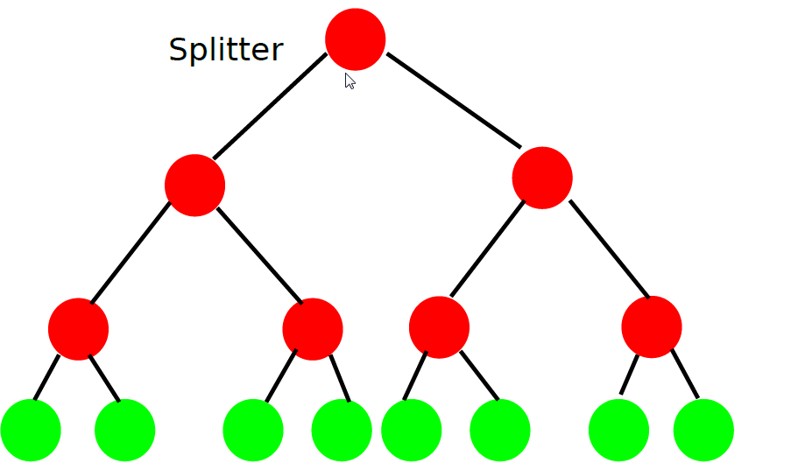
Tree – Phase 1
Lookup table with 2 read ports
4 cycles for 8 rounds
Leaf nodes
8 at a time
Power(8bits) | SR1(6bits) | …….. | SR7(6bits)
256 Entries
113pS = 1 cycle
Phase 1

Slide 72
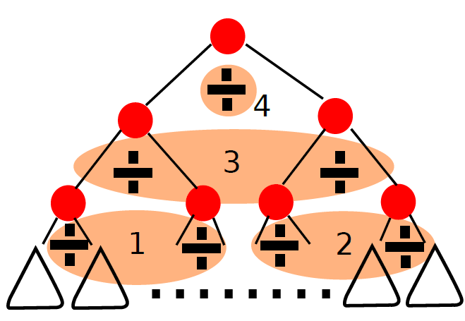
Tree – Phase 2
Reciprocal Cache
Single round
Single round
Two rounds
Div – 4 cycles
2 Dividers
Power(8bits) | SR1(6bits) | …….. | SR7(6bits)
Access– 1 cycle
Multiplication for power – 2 cycles
=> 4 rounds = 28 cycles
For N stations –
Phase 2

Slide 73
Creation of overlay
High
Low
1
20
4
5
13
6
7
8
30
2
3
Hybrid
17
19
8
3
9
10
14
12
13
14
15
16
6
11
Infreq
31
20
21
22
4
24
17
18
19
23
26
25
7
12
25
26
27
28
29
30
31
32
15
5
29
32
11
16
23
28
10

Slide 74
Operations in Overlay NUCA – Search
Home Bank
2
23
15
Two-Side Incremental (TSI)
27
20
Broadcast
18
31
5

Slide 75
Operations in Overlay NUCA - Eviction
Main Memory
Eviction from L2
Home Bank
18
20
21
31
24
32
26
29

Slide 76
TSI - Protocol
L1 Cache
Miss
L2 Cache Bank
If message type is request?
If space available in message queue?
Hit
Reply
If non home bank
Kill to home bank
Kill to opposite branch
Remove RCB Entry
Yes - Search
Miss
Type of Message ?
No – NACK to sender(Exponential back off)
Notify
RCB
Entry
Notify
Kill
Miss
Add notify
Home bank?
Create Entry in RCB (Home bank)
Yes
No
Remove MQ Entry
Any Child?
Hit
If notify = 2
Send request to Main memory
Remove entry from RCB
Remove entry from MQ
Yes
No
Miss
Send request message to children
Notify message to home bank

Slide 77
Configuration
System
Cores – 32
L1 cache
Block size- 64 B
L2 cache
Banks – 32
Main memory
Latency – 250 cycles
Auxiliary Structures
RCB – 128
Technology – 18nm
Frequency – 3.4 GHz
Write mode – Write back
Size – 32 KB
MSHR - 32
Associativity – 8
Write mode – Write back
Size – 256 KB
Memory controllers – 4
MQ – 16
VB - 20
Laser – Off chip

Slide 78
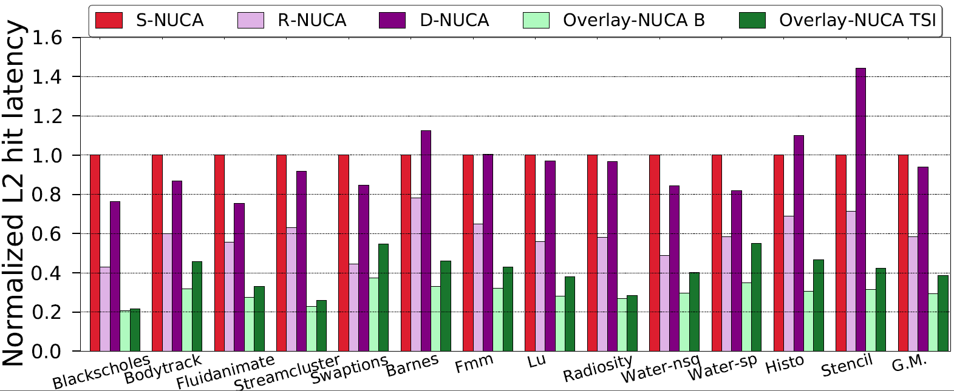
Results
Normalized Average Hit Latency
0.4-0.8
0.2-0.55

Slide 79
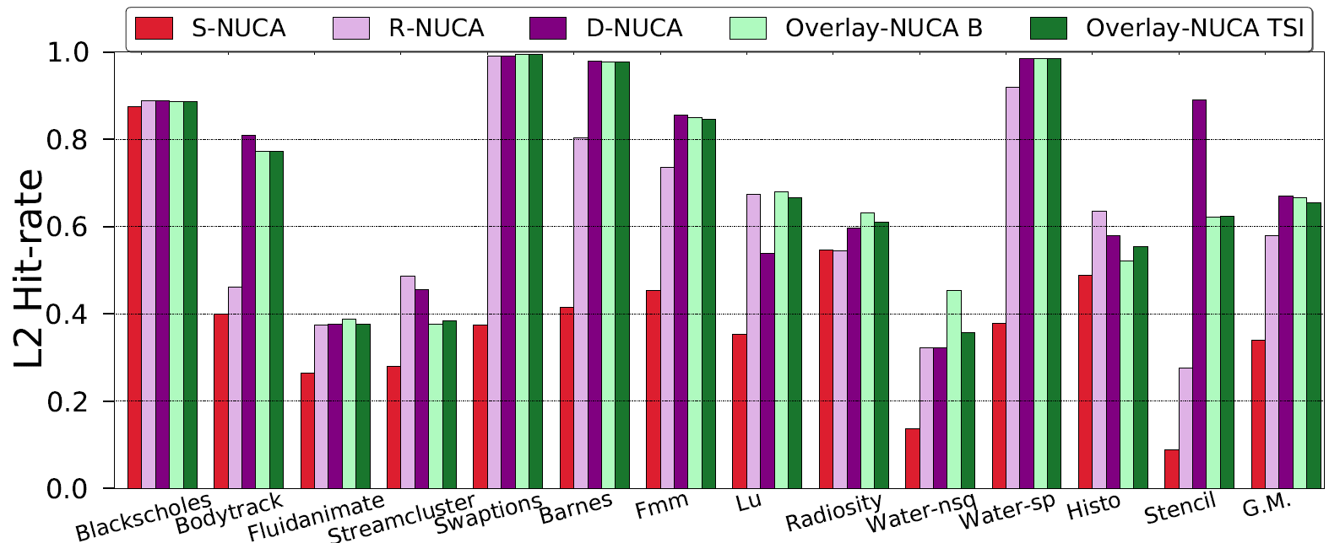
Results
More home bank hits
L2 Hit Rate
Comparable to DNUCA, much better than SNUCA

Slide 80
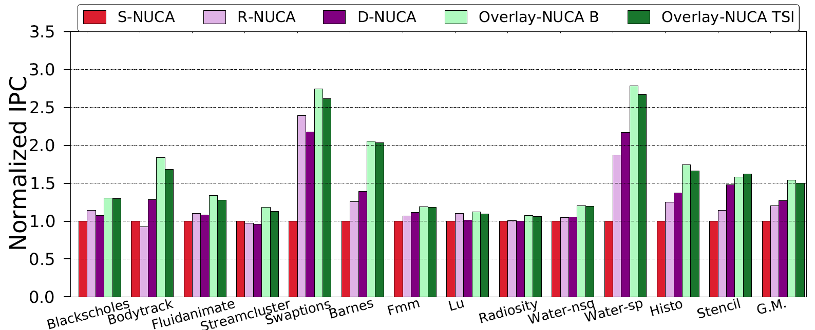
Results
Normalized IPC
161%
167%
2-3%
50, 24,18%
High non-home bank hits
Less L2 requests

Slide 81
Laser Controller
To Directory
Off-chip
ON-chip
Predictor WG
Tunable Splitter
Comb Splitter
Backbone WG
Extra WG
ERP WG

Slide 82
Station Controller
Backbone
WG
Data Transfer
Misprediction?
Couples light to another WG
Resonator
Station Controller
SWMR WG
Reservation
Channel
Extra WG
Message Queue
Predictor WG
ERP WG
Input Power
Prediction

Slide 83

Evaluation
ColdBus
ArchLink
35
16.8
4.1
Parsec, Splash, Parboil

Slide 84
Evaluation
Electrical
23
27.5
32
5

Slide 85
Evaluation
0.8
0.32
0.39
0.48

Slide 86
Dynamic Channel Sharing
Tree + Bus power distribution n/w
# of token = # of active waveguides
Any station can dynamically access a power waveguide
Power waveguides
in a p-cluster
Wait time
Pending requests
i^{th} & j^{th}
waveguide
i^{th} waveguide
j^{th} waveguide
Token i & j
Token
waveguide
Station m
Station n
Token i
Token j
Modulate and
send on WG i & j
Modulate and
send on WG m
Modulate and
send on WG n
Data
Waveguides
Separate arbitration is not needed for the data waveguide

Slide 87
Results
Multiple token at a time
Dynamic Sharing - One token at a time
No Laser Modulation – Max. tokens
No Laser Modulation – 1 token at a time
14%
20-30X

Slide 88
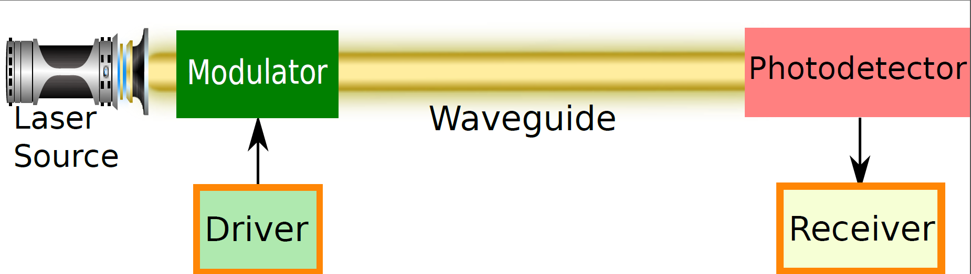
Optical Communication
S
D1
D2
D3
Basic Components
Reservation assisted Single Write Multi Read(R-SWMR)

Slide 89
Introduction
Modulate laser(ecolaser)
Prediction (Probe, ColdBus)
Laser Modulation
Static Power Consumption
Wavelength sharing
Channel Segmentation
Static schemes
Laser is turned on all the time
Channel Sharing

Slide 90
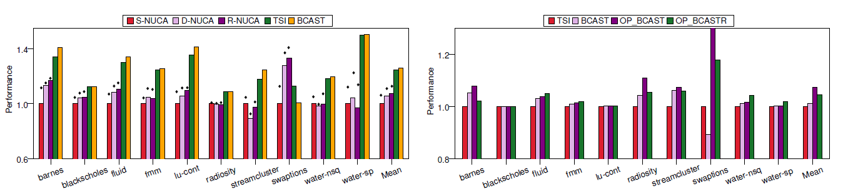
Performance

Slide 91
SWMR- Different Split Ratios
When β = 0
…..
1/(n-1)
1/3
1/2
ATAC and Probe – SWMR-P

Slide 92
SWMR and SWMR-S
Different split ratio
Same split ratio

Slide 93
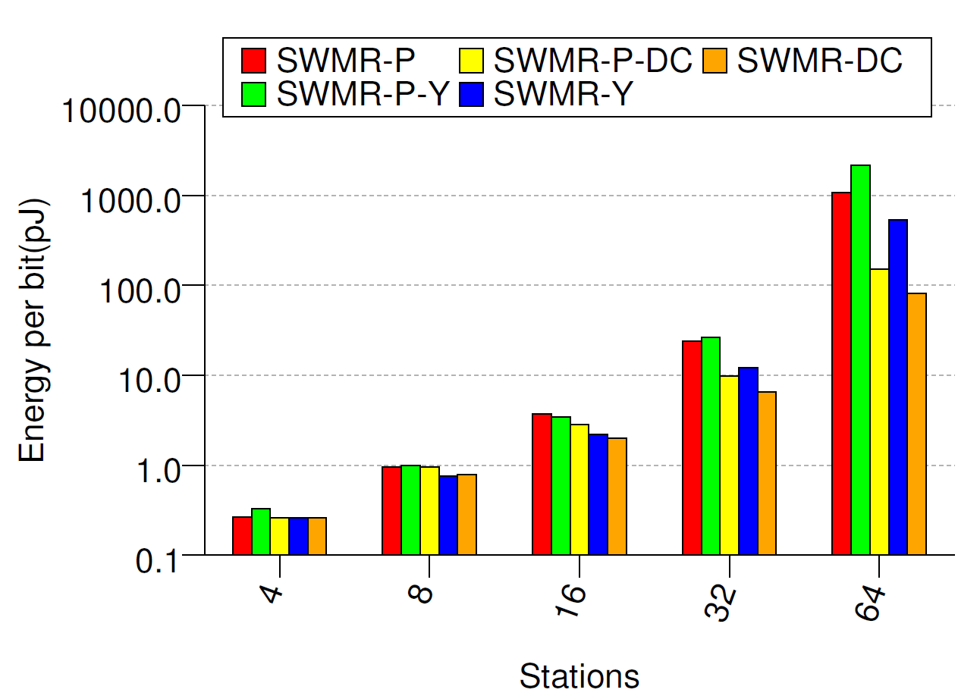
Evaluation
Split ratio – same
Splitter loss - 0.2 dB
Split ratio – same
Splitter loss - varies
Our Algorithm
Not Scalable
81 pJ
Half
3.73pJ
1.99pJ

Slide 94
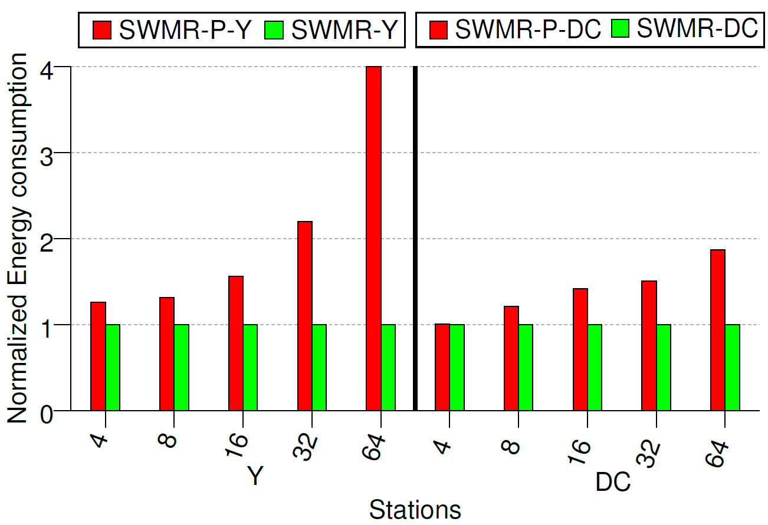
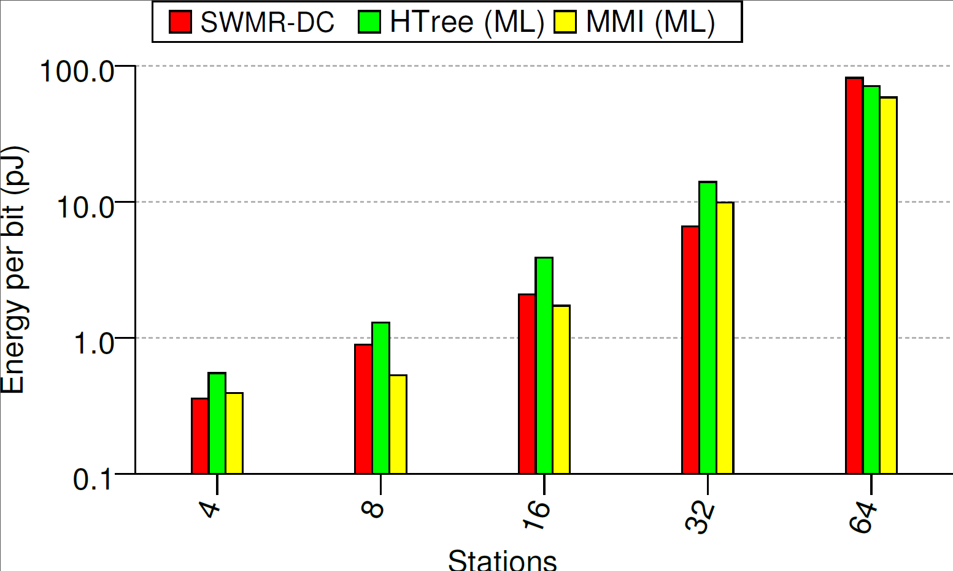
Evaluation
Multi Level
300%
120%
87%
25%
50%
0.1%

Slide 95
MMI(Multimode Interference coupler)
The signal splits because of:
Diffraction,
Reflection off the walls
Interference of the reflected waves
Needs to be designed delicately, and accurately.
Uses
Beam splitter
Optical multiplexer

Slide 96
Directional Coupler
The signal in one waveguide couples with the adjacent waveguide
Coupling depends on
Length of the parallel waveguide
Separation between these waveguides.
Uses:
Beam splitter

Slide 97
Microring Resonator
A circular waveguide (ring) is placed between two straight waveguides
The optical signal first gets coupled
to the ring, and then to the other
waveguide. (a.k.a resonance)
Uses:
(De)modulator
Optical switch

Slide 98
Y Junction
One waveguide splits into two
Split percentage depends on
Split angle
Width of the waveguide.
Uses:
Beam splitter
Optical multiplexer

Slide 99
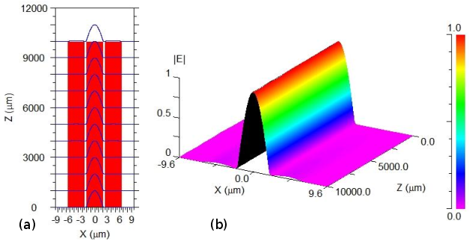
Parallel Waveguides
Propagation loss
Coupling loss
Coupling loss

